Slide 1

Web Application SECURITY Considerations

Slide 2
What Are We Going To COVER
Common Security Problems
SQL Injection
Parameter Tampering
Cross Site Scripting (XSS)
Cross Site Request Forgery (CSRF/XSRF)
Other threats

Slide 3
Common Security Problems
SQL Injection
Cross Site Scripting (XSS)
URL/HTTP Manipulation Attacks (Parameter Tampering)
Cross Site Request Forgery (CSRF)
Brute Force Attacks (also DDoS)
Insufficient Access Control
Too Much Information in Errors/Public Configuration
Missing SSL (HTTPS) / MITM
Phishing/Social Engineering
Security Flows in Other Software We Use

Slide 4
SQL Injection
By default ORMs prevent SQL injection
But be careful with raw queries (including Dapper)
Consider the following query:
It can be transformed to match all entries:
Or insert new data:
SELECT * FROM Messages WHERE MessageText LIKE '%Code It Up%'"
SELECT * FROM Messages WHERE MessageText LIKE '%' or 1=1 --%'"
SELECT * FROM Messages WHERE MessageText
LIKE '%'; INSERT INTO Messages(MessageText, MessageDate) VALUES ('Code It Up!!!', '20.10.2020') --%'"

Slide 5
SQL Injection
You can even get access to a poorly written website’s administration
If we have the following query in our code:
Setting username to John & password to ' OR '1'= '1 produces
The result:
The user with username – “Admin” will login WITHOUT password
The pass query will turn into a bool expression which is always true
String query = "SELECT * FROM user WHERE name = '" + username + "' AND pass='" + password + "'";
String sqlQuery = SELECT * FROM user WHERE name = 'Admin' AND pass='' OR '1'='1'

Slide 6
Parameter tampering
Parameter Tampering is the manipulation of parameters exchanged between client and server
Altered query strings, request bodies, cookies
Skipped data validations, Injected additional parameters
The ASP.NET Core model binging is vulnerable to this attack
If you are not careful
Make sure your input models include only the properties you want
Don’t leave any other properties because they can be easily altered
A malicious request may change data you don’t want

Slide 7
Cross site scripting (XSS)
XSS is including unwanted scripts in your page
Because the inputs are not sanitized
Basically, an attacker uses a form to store a script tag in the application database
Then on a view page that script is rendered and executed
This way cookies or other sensitive information may be stolen from the user
By default, ASP.NET Core and Razor save you from these attacks
But sometimes, you may want to render HTML content
You can use @Html.Raw(someHtml)
For example, in a blog or in a rich UI
Then you need to be super careful

Slide 8
Cross site scripting (XSS)
There are several rules you must follow to be secured:
Never put untrusted data into your HTML output
Before putting untrusted data somewhere, ensure it is secured
Encoded, Parsed, Validated, Checked for malicious contents
Untrusted data can be inputted anywhere in the application
URLs, HTML Elements, HTML Attributes, JavaScript code etc.
You can use a third-party tool to sanitize any user data
It is called HtmlSanitizer and it is available as a NuGet package
https://github.com/mganss/HtmlSanitizer

Slide 9
Cross site REQUEST FORGERY (CSRF/XSRF)
Cross-Site Request Forgery (CSRF / XSRF) is a web security attack over the HTTP protocol
Allows executing unauthorized commands on behalf of some user
By using his cookies stored in the browser
The user has valid permissions to execute the requested command
The attacker uses these permissions maliciously, unbeknownst to the user
In ASP.NET Core there are built-in mechanisms to protect your application
It is automatically generated, and you can add the defense globally
You need to add ValidateAntiforgeryToken or AutoValidateAntiforgeryToken

Slide 10
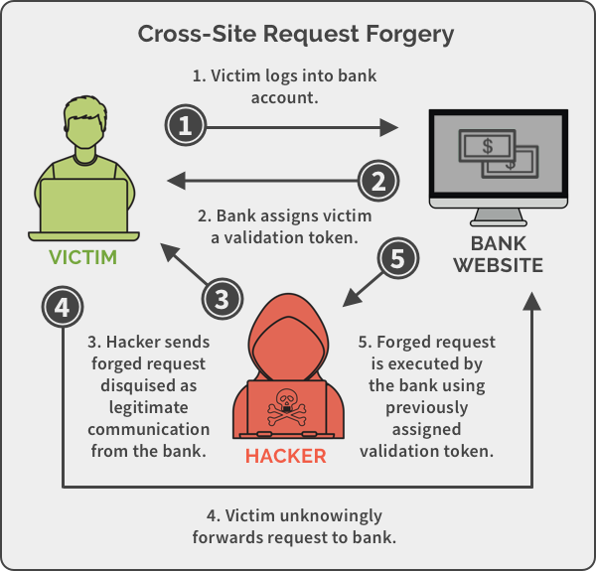
Cross site REQUEST FORGERY (CSRF/XSRF)

Slide 11
Cross site REQUEST FORGERY (CSRF/XSRF)
Example form on a malicious site:
Even if the user recognizes the site is different
She may still click on the button by mistake
Therefore you still need to secure it
<form action="http://good-banking-site.com/api/account" method="post">
<input type="hidden" name="Transaction" value="withdraw">
<input type="hidden" name="Amount" value="1000000">
<input type="submit" value="Click to collect your prize!">
</form>

Slide 12
Other threats
Brute Force Attacks (also DDoS)
Insufficient Access Control
Too Much Information in Errors/Public Configuration
Missing SSL (HTTPS) / MITM
Phishing/Social Engineering
Security Flows in Other Software We Use

Slide 13
ANY QUESTIONS?

